Slide 1
Understanding JavaScript Object Creation Patterns

Slide 2
Topics
Plain old objects
Constructor functions
The inner workings of 'new'
Exploring the prototype chain and instanceof
When is a prototype not a prototype?
The constructor property
The confusing world of 'this'
Private parts
Using closures for private state
Summary
Conclusions

Slide 3
Plain old objects
Simply a collection of named properties
Property consists of a name and a value that can be of any type
Objects are dynamic

Slide 4
Plain Old Objects
Can be initialized like so…
var shape = {};
shape.color = 'red';
shape.borderThickness = '2.0';

Slide 5

Plain Old Objects
var shape = {
color : 'red',
borderThickness : '2.0'
}

Slide 6
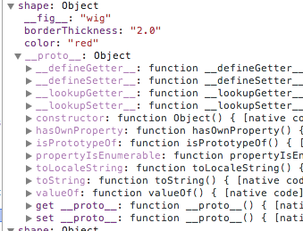
Plain Old Objects
The __proto__ property points to this object's prototype

Slide 7
Plain Old Objects
Demonstrates true nature of inheritance in JavaScript
If you try to access a property of an object…
Firstly object itself is examined by the JavaScript runtime
If not found there it checks the object's prototype
And so on all the way up the prototype chain

Slide 8
Plain Old Objects
Javascript is very dynamic
But types are not defined when creating objects
Lets look at the Javascript way

Slide 9
Constructors
Consider this example with a method…
var shape = {
color : 'red',
borderThickness : '2.0',
describe : function() {
console.log("I am a " + this.color + " shape, with a border that is " +
this.borderThickness + " thick");
}
}
You might want to create multiple instances of this object

Slide 10
Constructors
Creating a constructor function
function Shape(color, borderThickness) {
this.color = color;
this.borderThickness = borderThickness;
}

Slide 11
Constructors
Instantiating an object based on constructor
function Shape(color, borderThickness) {
this.color = color;
this.borderThickness = borderThickness;
}
var shape = new Shape('red', 2.0);

Slide 12
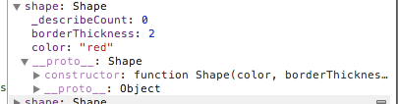
Constructors
Very similar to previous initialized example
There is one subtle difference
__proto__: Shape

Slide 13
Constructors
We could add methods to the Shape constructor…
function Shape(color, borderThickness) {
this.color = color;
this.borderThickness = borderThickness;
this.describe = function(){…};
}

Slide 14
Constructors
Or to the prototype…
function Shape(color, borderThickness) {
this.color = color;
this.borderThickness = borderThickness;
}
Shape.prototype.describe = function() {
…
};

Slide 15
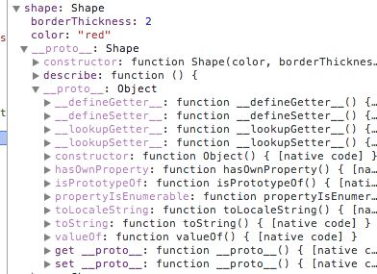
Constructors
describe method will be inherited by all Shape instances
Note that Object sits at the base of the prototype chain

Slide 16
The new Keyword
When a function is invoked using new, the following occurs:
A new instance of an object is created and its prototype (exposed via the __proto__ property) is set to the prototype property of the constructor function.
The constructor function is invoked with the newly created object bound to the this property.
If the function does not return a value, this is returned implicitly.

Slide 17

The new Keyword
Try invoking the constructor function without the new keyword…

Slide 18
The new Keyword
Easily fixed…
function Shape(color, borderThickness) {
this.color = color;
this.borderThickness = borderThickness;
return this;
}

Slide 19
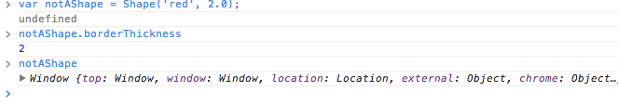
The new Keyword
But…
Our shape is not a Shape, it is in fact a reference to the global Window object – bad!

Slide 20
The new Keyword
A constructor function when invoked without the new keyword will obey the standard rules regarding the binding of this
this results in this being the global object
constructor functions must be invoked via the new keyword or bad things will happen
It is the new keyword that does all the work

Slide 21
Prototype Properties
Properties can be added to the prototype
These will be shared across all object instances
Similar concept to static properties

Slide 22
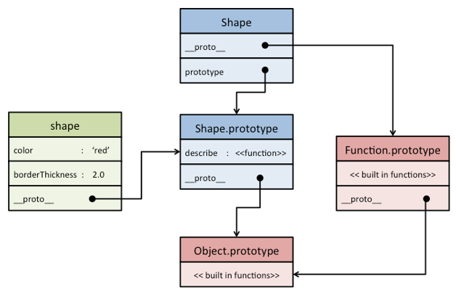
Prototype Summary

Slide 23
instanceof
shape.__proto__ == Shape.prototype
shape.__proto__.__proto__ == Object.prototype
Both would return true
As would…
shape instanceof Shape;
shape instanceof Object;

Slide 24
instanceof
The instanceof keyword navigates the prototype chain, returning true if anywhere in the chain is the object pointed to by the given constructor function's prototype property

Slide 25
instanceof
the new keyword constructs an object with its internal prototype set to the prototype of the constructor function
an instanceof check for this should return true
protect against the use of the constructor function without the new keyword

Slide 26
instanceof
function Shape(color, borderThickness) {
//check for Shape type…
if (!(this instanceof Shape)) {
//if new keyword not used to create object…
return new Shape(color, borderThickness);
}
this.color = color;
this.borderThickness = borderThickness;
}

Slide 27
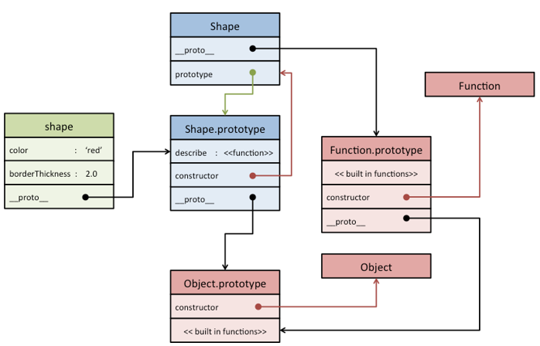
constructor Property

Slide 28

constructor Property

Slide 29
The this Keyword
Add an event handler to the occasion…
// create a shape
var shape = new Shape('red', 2.0);
// ask it to describe itself
shape.describe();
//
$('#foo').click(shape.describe);
I am a red shape, with a border that is 2 thick
// I am a undefined shape, with a border that is undefined thick

Slide 30
The this Keyword
Wrap within a function…
$('#foo').click(function() { shape.describe(); });
// I am a red shape, with a border that is 2 thick

Slide 31
The this Keyword
Need to know a little bit about the concept of 'execution contexts’
All JavaScript code execution takes place within an execution context
Each context contains information regarding the variables that are currently in scope and the value that is bound to this

Slide 32
The this Keyword
A new execution context is created when a method is invoked, where this is a reference to the object that owns the property

Slide 33
The this Keyword
The click event invokes this function directly, rather than invoking it via shape
As a result it is executed within the scope of the click execution context
this references the DOM element that was clicked
$('#foo').click(shape.describe);

